Slide 1
Social-Affective Prediction (SAP) Control Task Egg Task

Slide 2
Practice Task Slides (12 trials)

Slide 3
Welcome to the egg task.
In this task you play the role of a store owner who is known for offering a good variety of speciality eggs. You are at your local farmer’s to buy fresh eggs for your store. Some of the eggs are more sensitive and spoil quicker. If you buy good eggs, you will make a profit when reselling them at your shop. When you buy bad eggs you loose money because you cannot resell them.
Because there are different sorts of eggs, you have to learn which ones are more likely to be rotten and which ones are more likely to stay fresh.
Try to make as much profit as possible by collecting as many and a high variety of fresh eggs as possible. Because that is what makes your store so special.
To make sure the different sorts of eggs look different enough, we reused some of the faces from the last task you played.

Slide 4
Welcome to the egg task.
This is the general setup of the task:
1. You will see an egg (with a face on it to make it easier to distinguish between eggs)
2. You are asked if you want to collect the egg or not
3. You will see the egg that you collected. Wait until you know whether it is spoiled or not.
4. You see a coin if you collected a profitable egg or rejected a bad egg or you see a crossed out coin if you bought a bad egg or missed out on buying a good egg.
Your goal is to get as many different fresh eggs as possible.

Slide 5
Welcome to the egg task.
You will now play the egg task that you practiced just beforehand.
Do not forget that there are different sorts of eggs and you have to learn which ones are more likely to get spoiled and which ones are more likely to stay fresh.
Try to make as much profit as possible by collecting as many fresh eggs as possible.
As you saw in the practice, we used faces to represent the eggs. The actual faces on the eggs have nothing to do with the task itself. We previously used black and white eggs with patterns on them but it was too difficult to tell the differences between the eggs. So, just bear in mind, this is a task about making profit from collecting the right egg.
The task is going to take about 10-15 min.

Slide 6
POINTS
If an egg that you buy is spoiled, you will lose money and a point. If you refrain from collecting an egg that would have been fresh, you also lose a point. You gain points if you buy fresh eggs or correctly refuse spoiled eggs offered by the farmer.
If you can reach 50 points across all tasks you will earn an additional 5$ on top of the participation reimbursement.
If you reach 100 points across all tasks you will earn an additional 5$ on top of the participation reimbursement and the 50-point bonus.
After each task you will learn how many points you collected.

Slide 7
POINTS
If an egg that you buy is spoiled, you will lose money and a point. If you refrain from collecting an egg that would have been fresh, you also lose a point. You gain points if you buy fresh eggs or correctly refuse spoiled eggs offered by the farmer.
If you can reach 80 points across all tasks you will earn an additional 5$ on top of the participation reimbursement.
If you reach 160 points across all tasks you will earn an additional 5$ on top of the participation reimbursement and the 80-point bonus.
After each task you will learn how many points you collected.

Slide 8
First, a short practice of the egg task.
We will start with 4 practice rounds to make you familiar with the task. During these first 4 rounds there will be slightly more text presented here and you can ask questions at any time.

Slide 9
The egg task is starting anytime now...

Slide 10
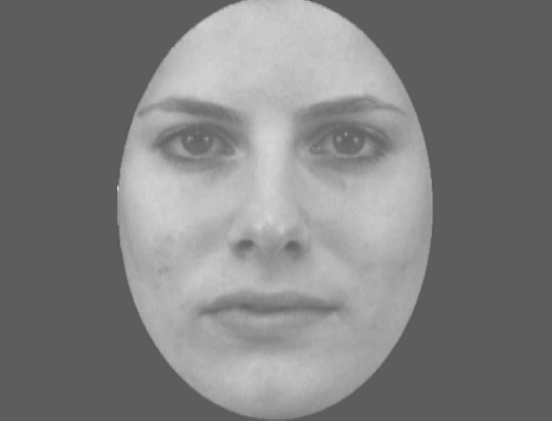

Slide 11
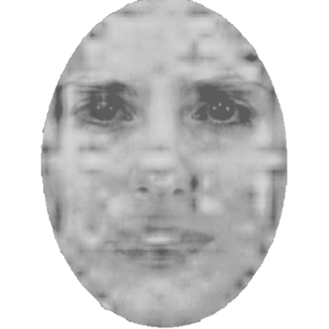

Slide 12
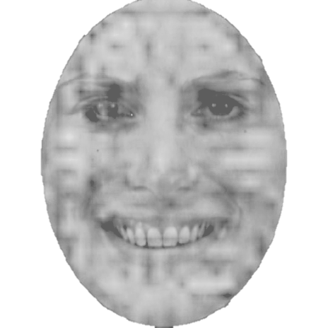

Slide 13


Slide 15
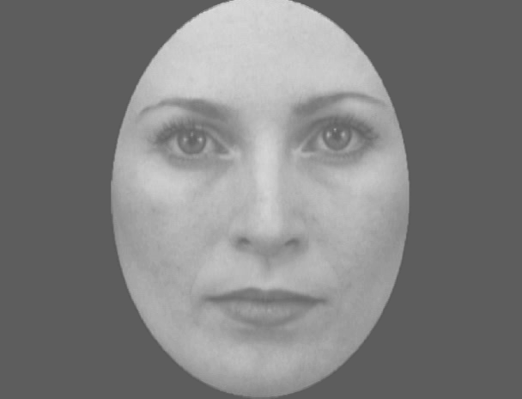

Slide 16
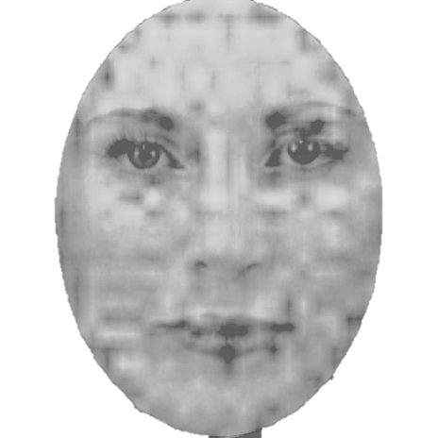

Slide 18
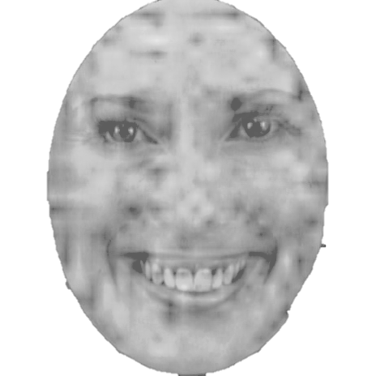

Slide 21
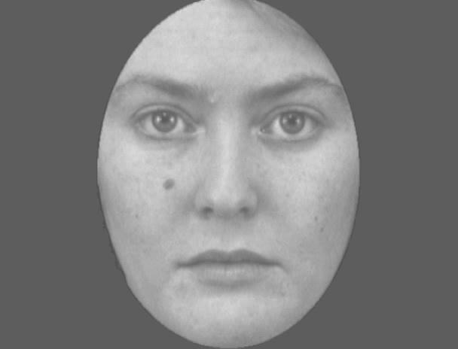

Slide 22
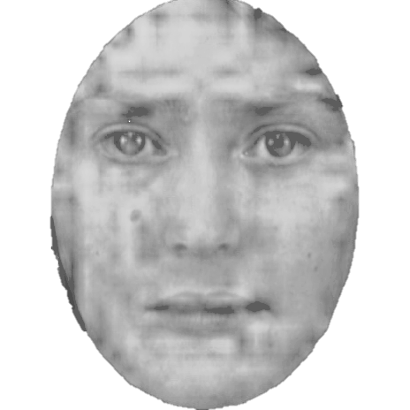

Slide 24
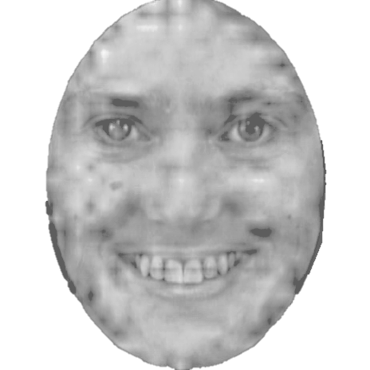

Slide 26
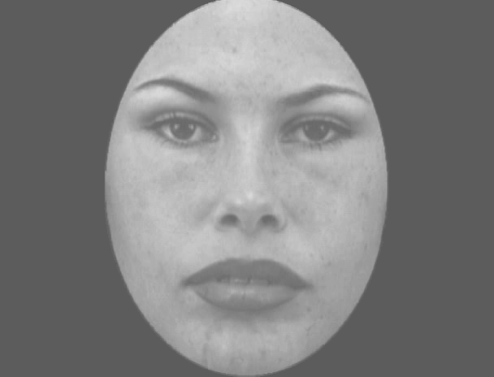

Slide 27
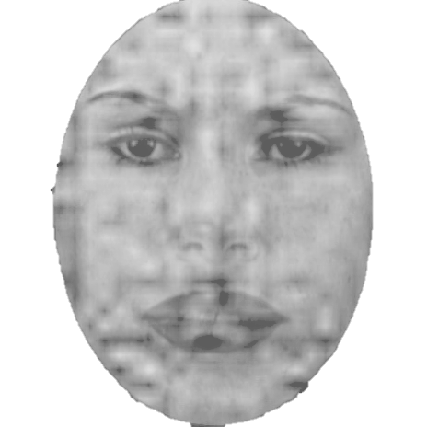

Slide 29
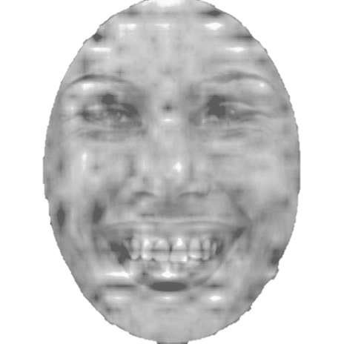

Slide 31
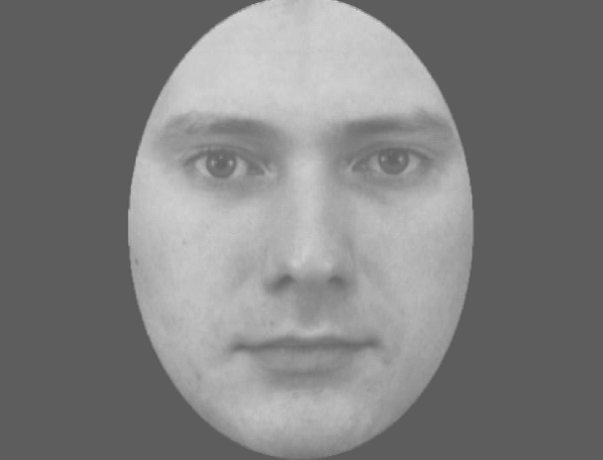

Slide 32
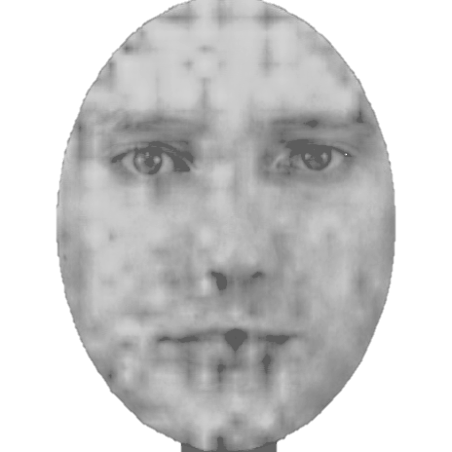

Slide 33
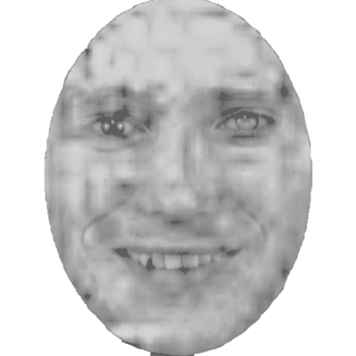

Slide 36
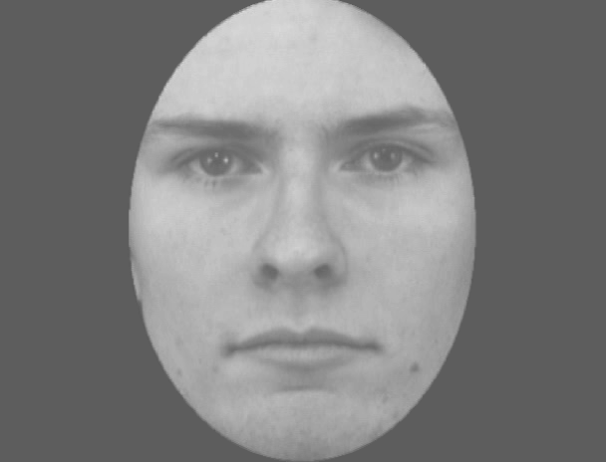

Slide 37
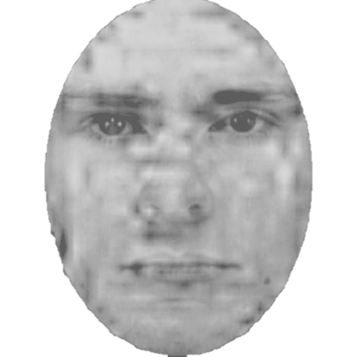

Slide 38
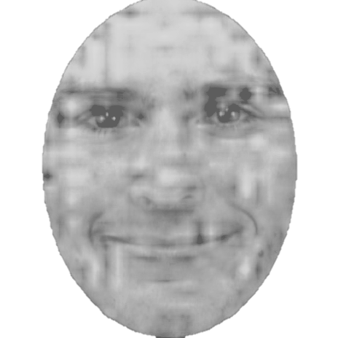

Slide 41
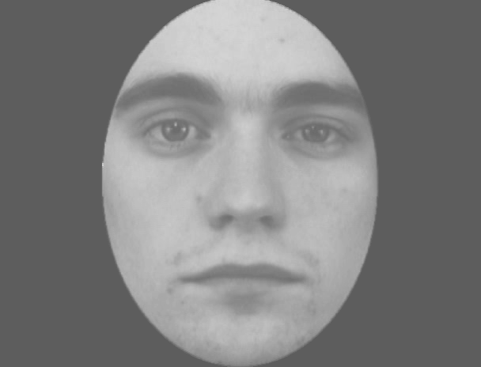

Slide 42
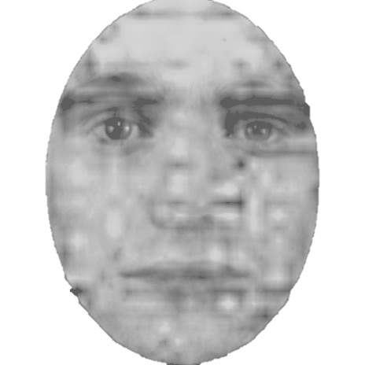

Slide 43
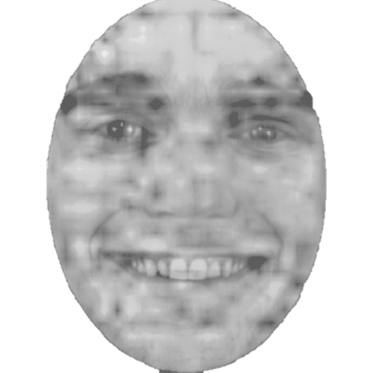

Slide 46
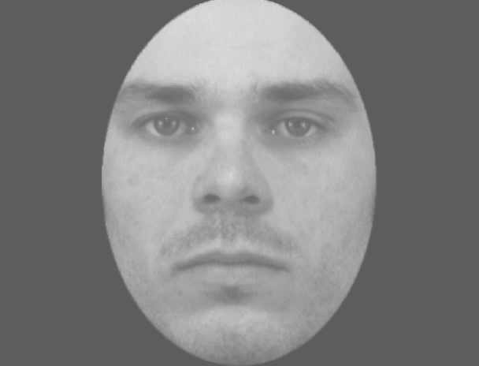

Slide 47
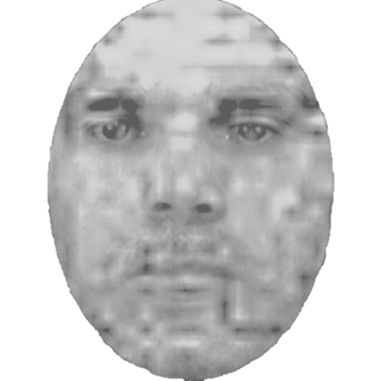

Slide 48
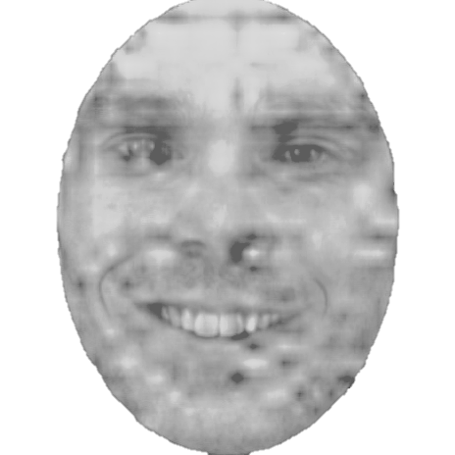

Slide 49
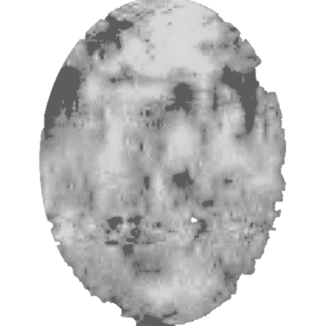

Slide 52
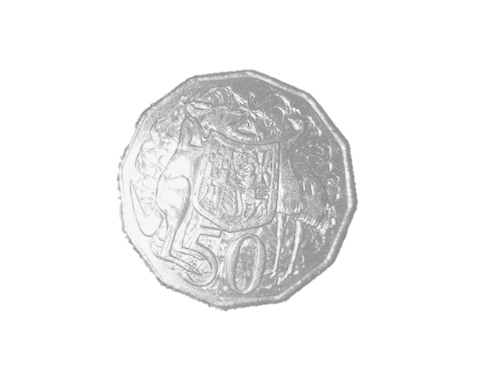

Slide 53
You collected an egg that you could resell. You made a profit!

Slide 54
You rejected an egg that was rotten. You did not loose your money.

Slide 55

You collected an egg that was rotten. You should have rejected this egg. You lost money.

Slide 56
You rejected an egg that you could have resold.
You should have collected this egg. You lost out on making profit.

Slide 57
+

Slide 58
+ 1

Slide 59
- 1

